Slide 1


Beyond the Needle: Attention-Based Multimodal Deep Learning for Anemia Screening Through Ablation Studies and Comparative Benchmarking
(Group: G4)
Team AI Goriber Genie
Jasmin Sultana Shimu (0112230353)
Sayma Sultana (0112230948)
Md Fazley Rabbi (0112230944)
Tasmim Jahan Rimvy (0112230846)
Supervisor Name: Dr. Jannatun Noor Mukta
Co-Supervisor Name: Khushunur Binte Jahangir

Slide 2
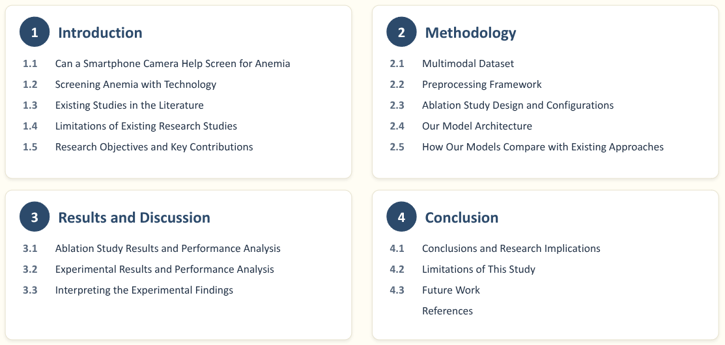
Table of Content
2

Slide 3

1. Introduction
3

Slide 4
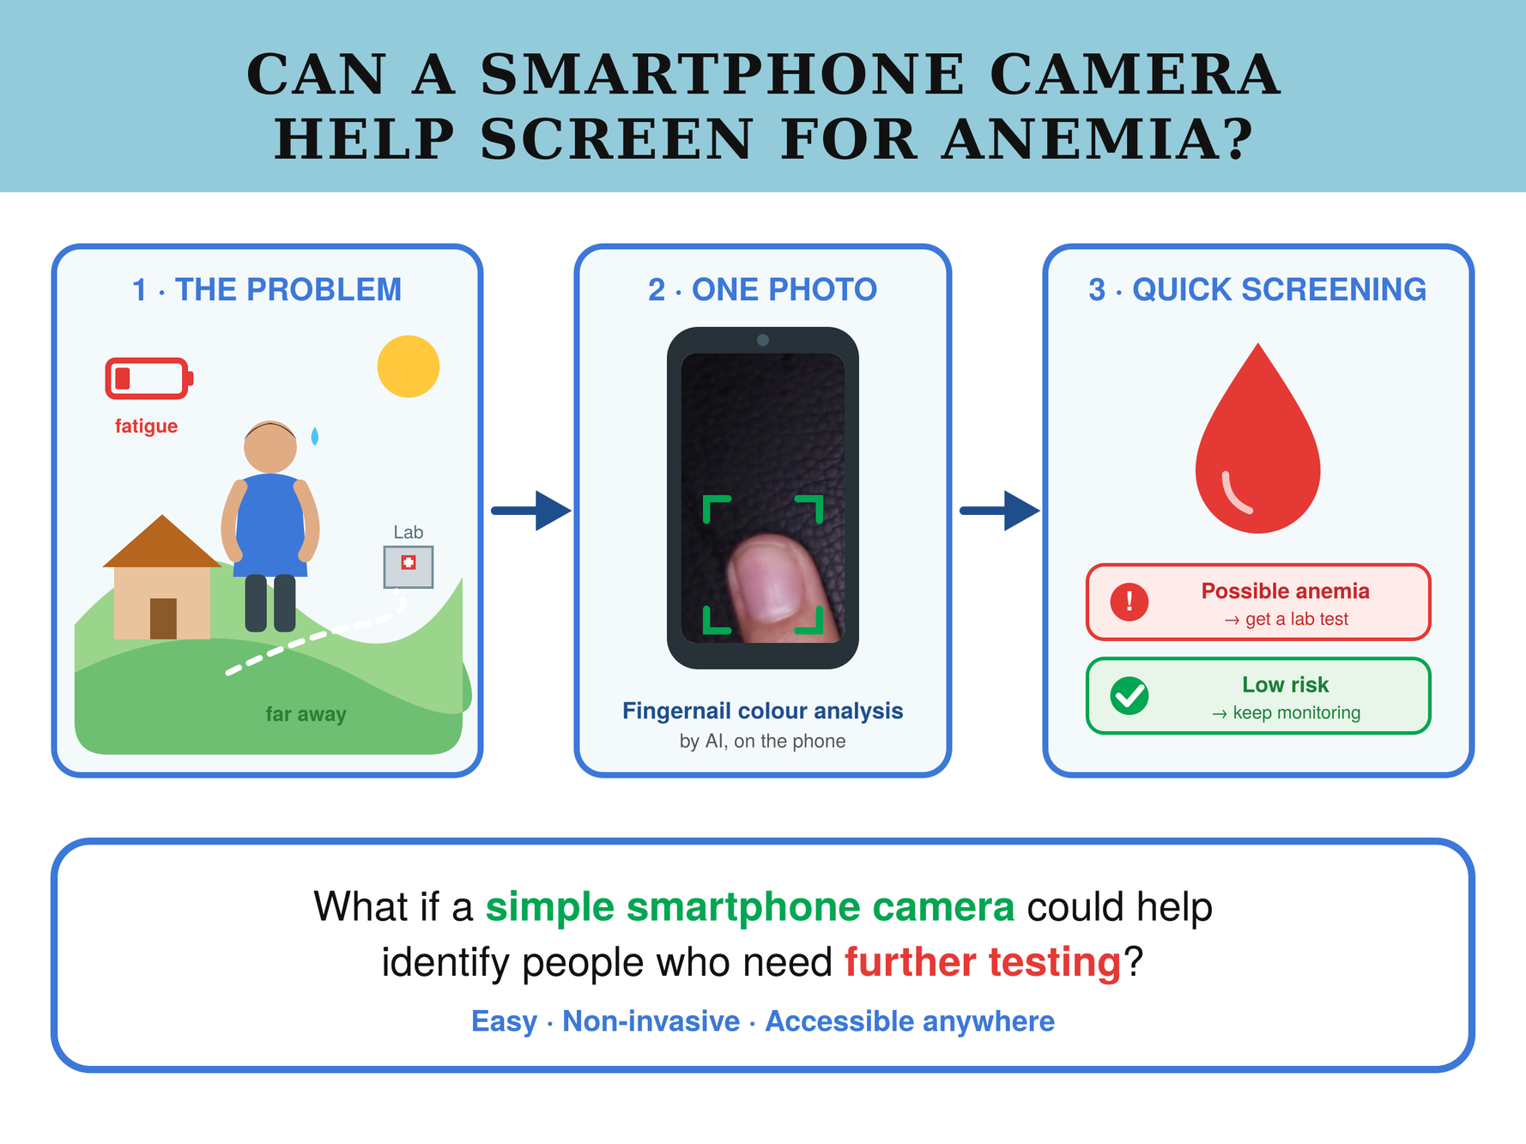
1.1 Can a Smartphone Camera Help Screen for Anemia
4

Slide 5
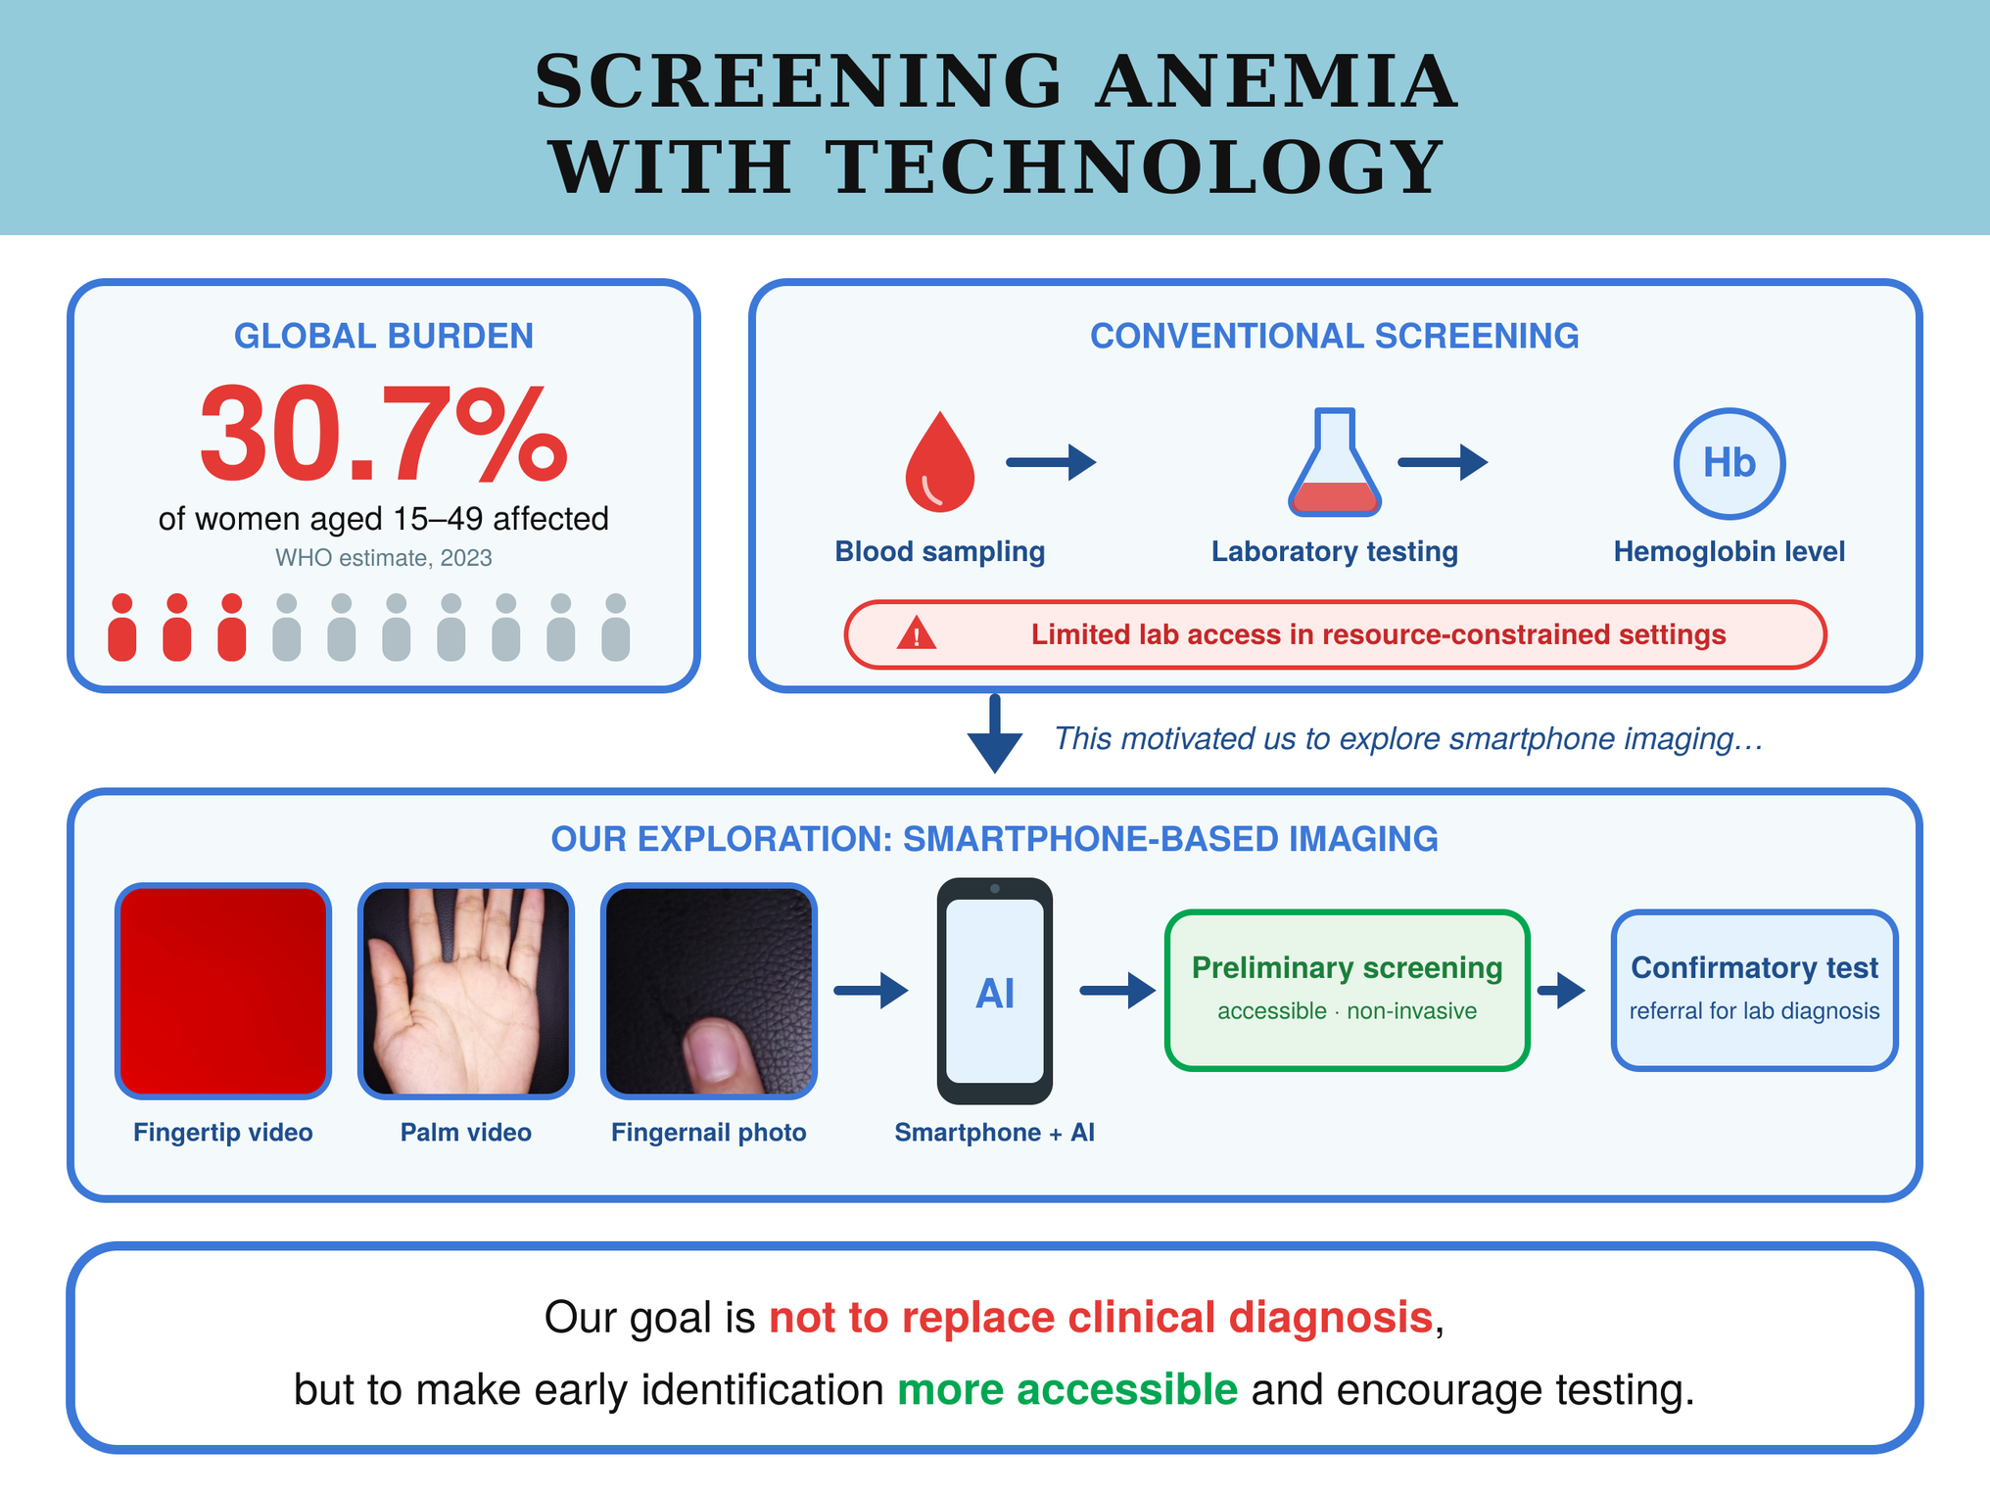
1.2 Screening Anemia with Technology: Background and Motivation
5

Slide 6
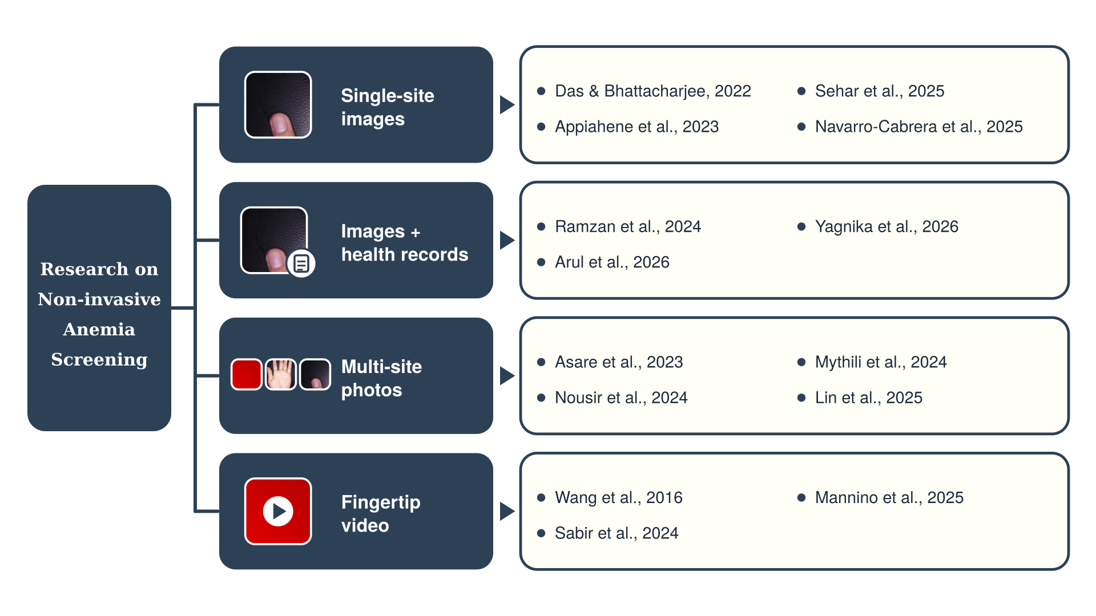
1.3 Anemia Detection from Body-Site Images: Existing Studies in the Literature
6

Slide 7
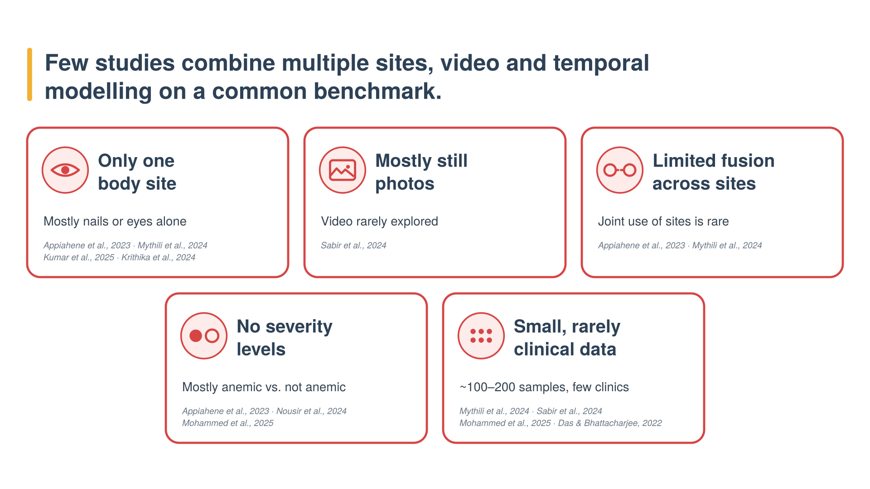
1.4 Limitations of Existing Research Studies
7

Slide 8
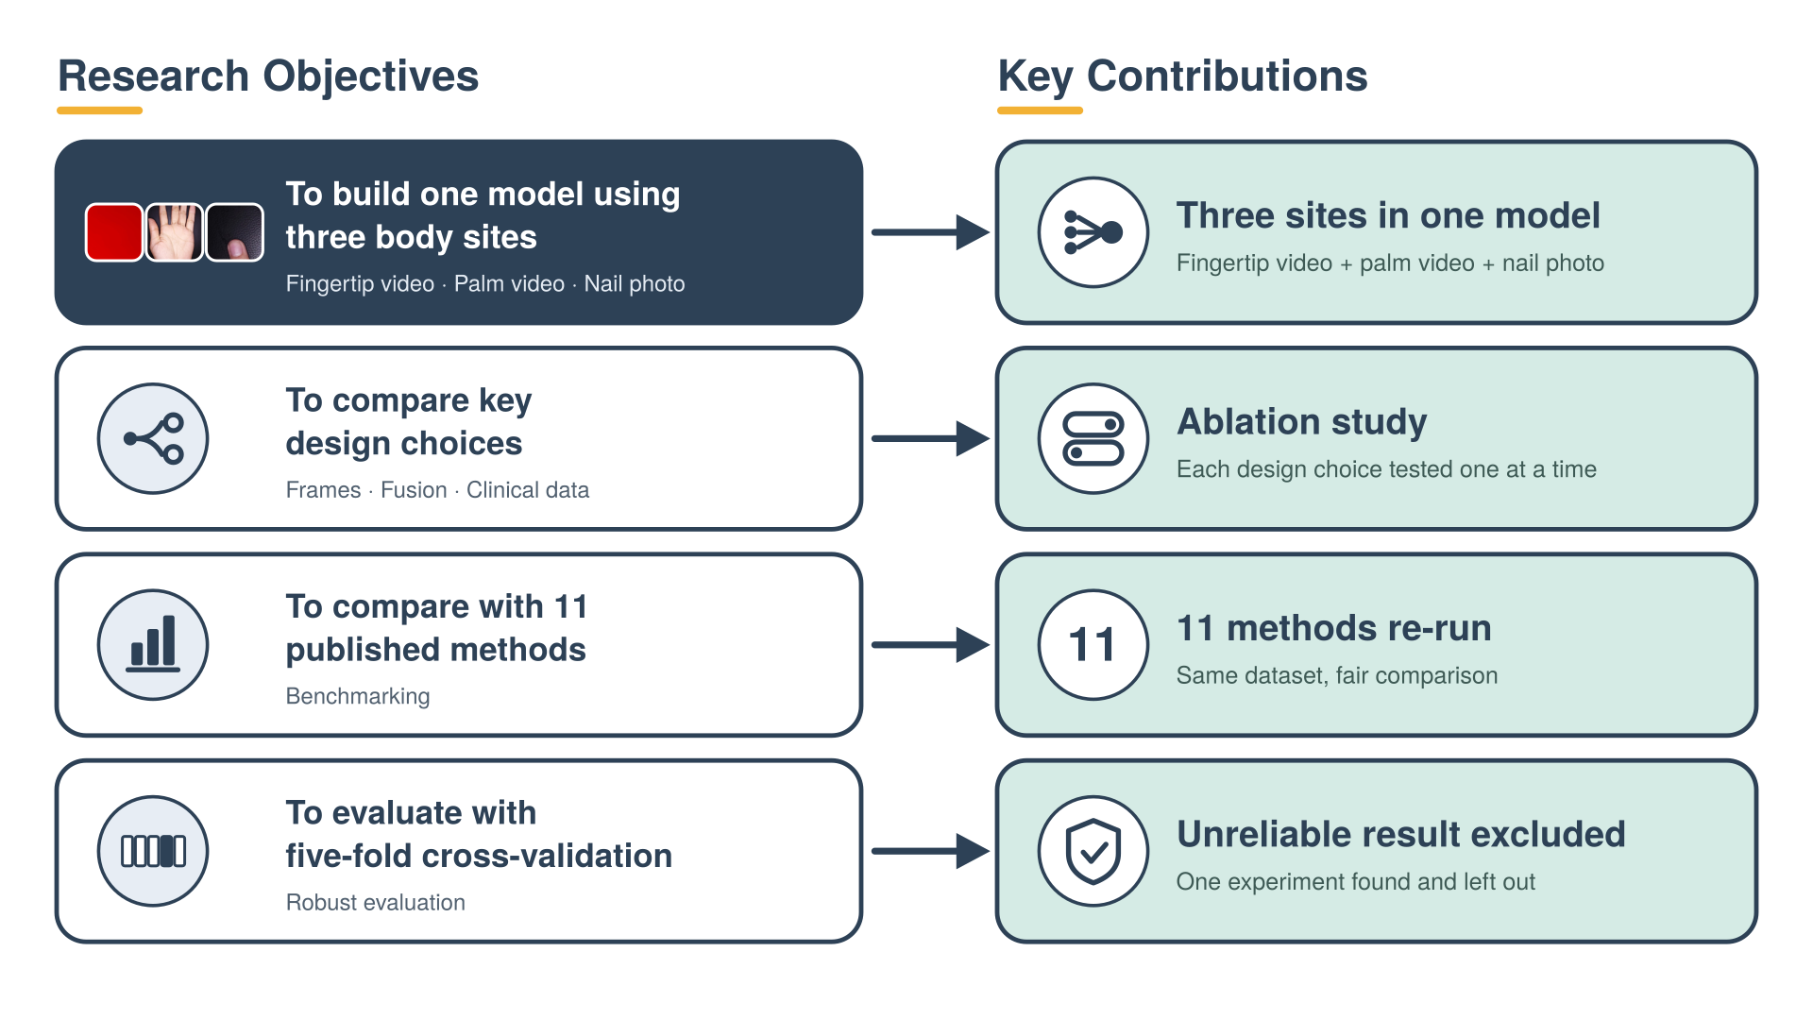
1.5 Research Objectives and Key Contributions
8

Slide 9
2. Methodology
9

Slide 10
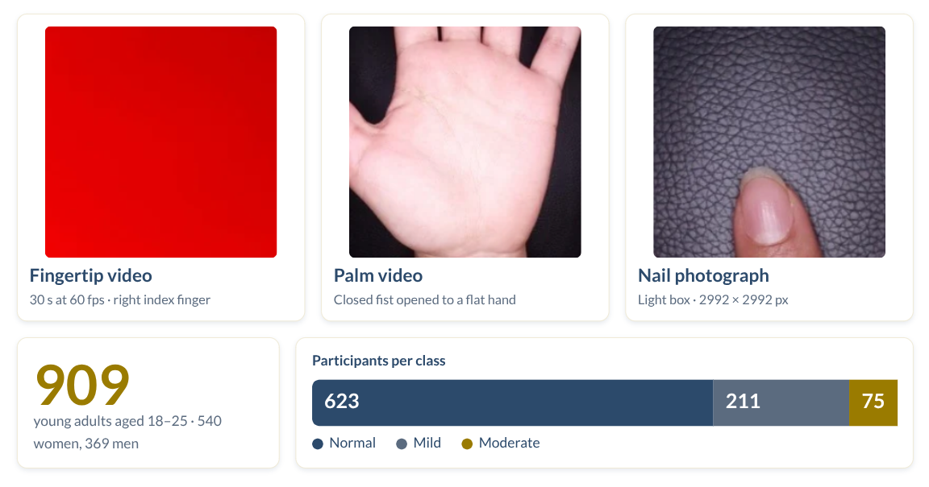
2.1 Multimodal Dataset
Dataset Name: Non-invasive Multimodal Dataset for the Detection of Iron Deficiency Anemia in Young Adults
10

Slide 11
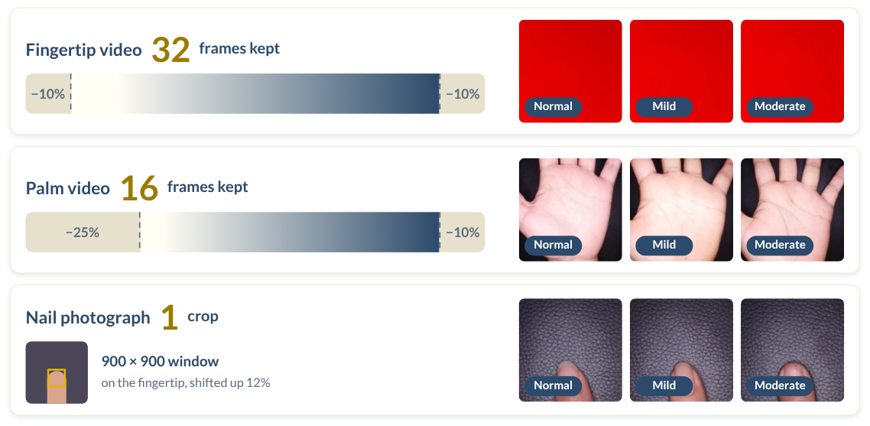
2.2 Preprocessing Framework
Preprocessing Information
11

Slide 12
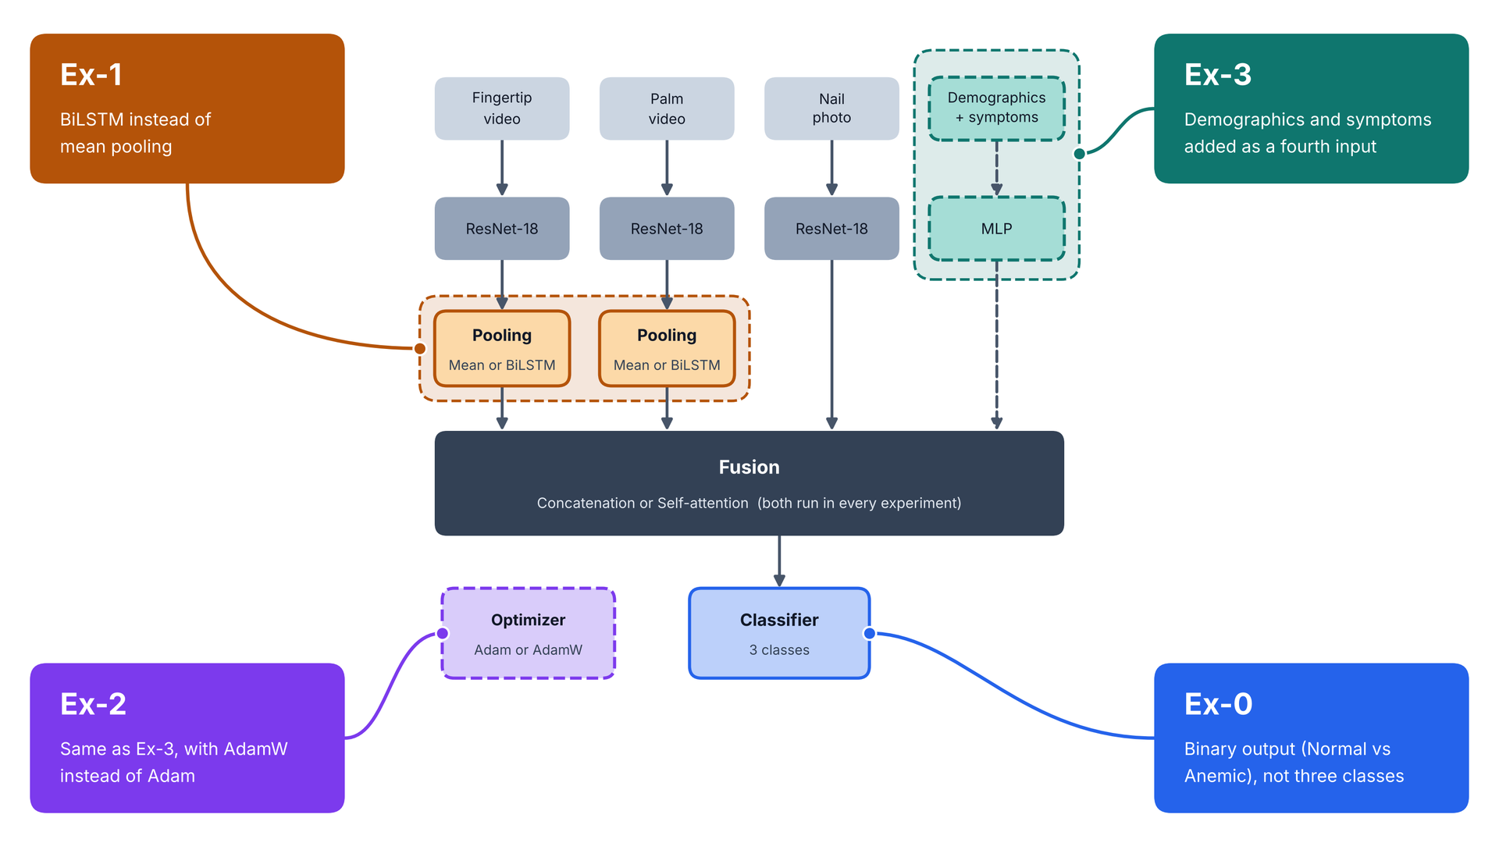
2.3 Ablation Study Design and Experimental Configurations
(Ablation Configurations)
12

Slide 13
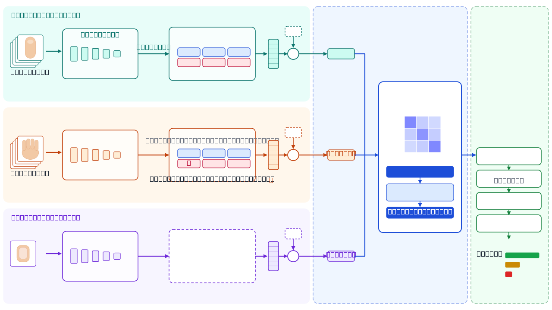
2.4 Our Model Architecture
model: ex-1: images only, with BiLSTM and self-attention.
Self-attention fusion
1 encoder layer · d=256 · 4 heads · FFN 512 · dropout 0.3
Mild
Moderate
13
Figure: The model takes three inputs per patient: a fingertip video, a palm video and a nail photo. It turns each into a 256-number summary, lets the three summaries share information using self-attention, and then predicts the class (Normal, Leve or Moderada).

Slide 14
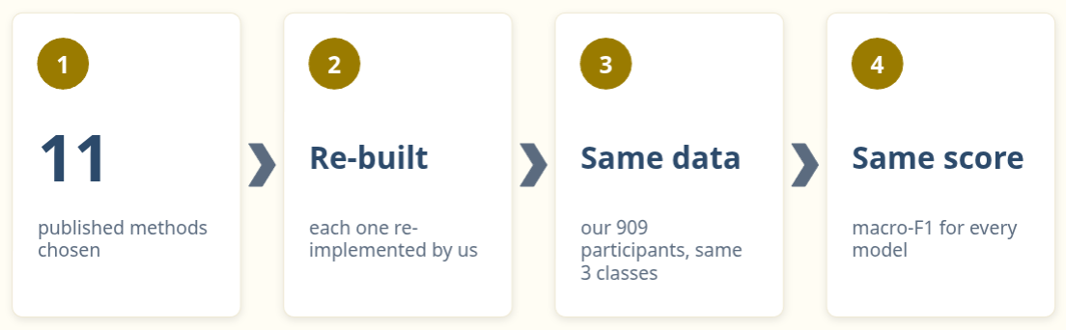
2.5 How Did Our Models Compare with Existing Approaches?
(Benchmarking)
14

Slide 15
Results and Discussion
3.
15

Slide 16
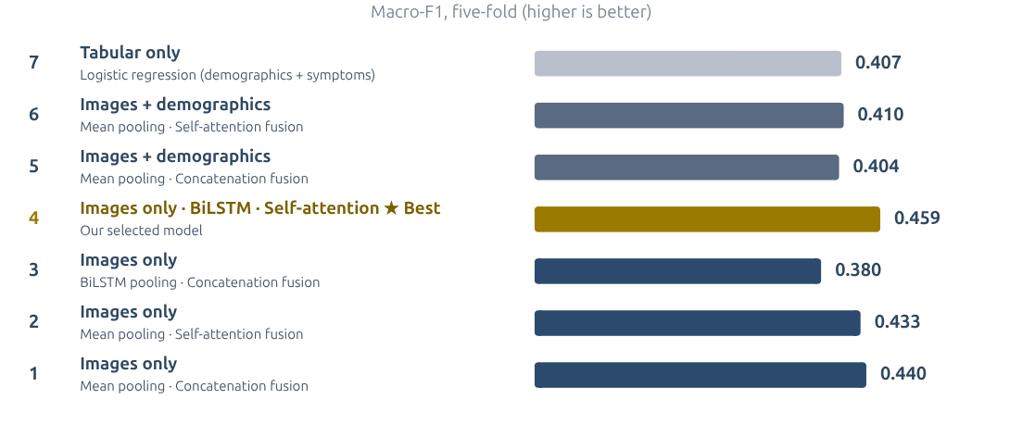
3.1 Ablation Study Results and Performance Analysis
(Ablation results)
Figure : Ablation results (5-fold CV, mean ± SD). The highlighted configuration performs best.
16

Slide 17
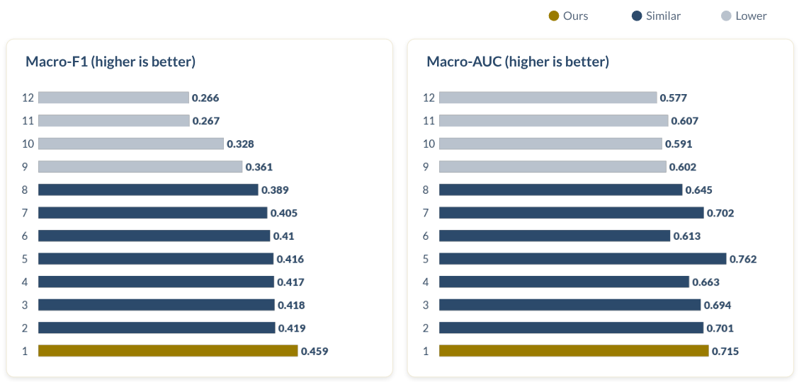
3.2 Experimental Results and Performance Analysis
(Bench-marking Results)
17
Figure : Macro-F1 and Macro-AUC Comparison of Benchmark Models

Slide 18
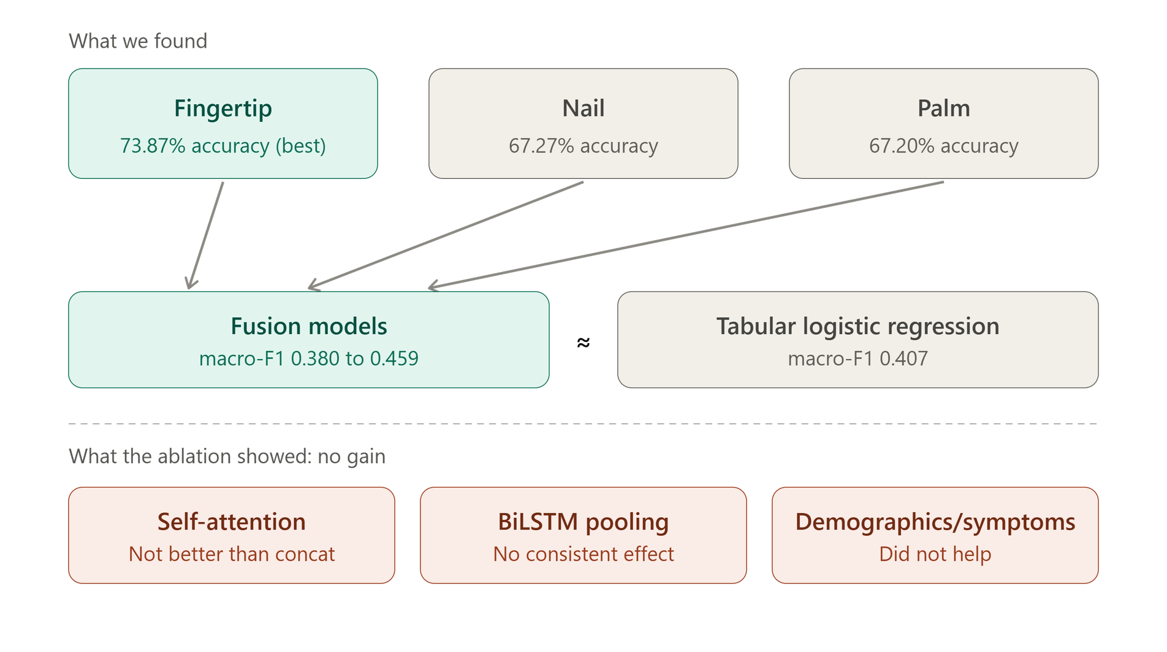
3.3 Interpreting the Experimental Findings
(Discussion)
18

Slide 19
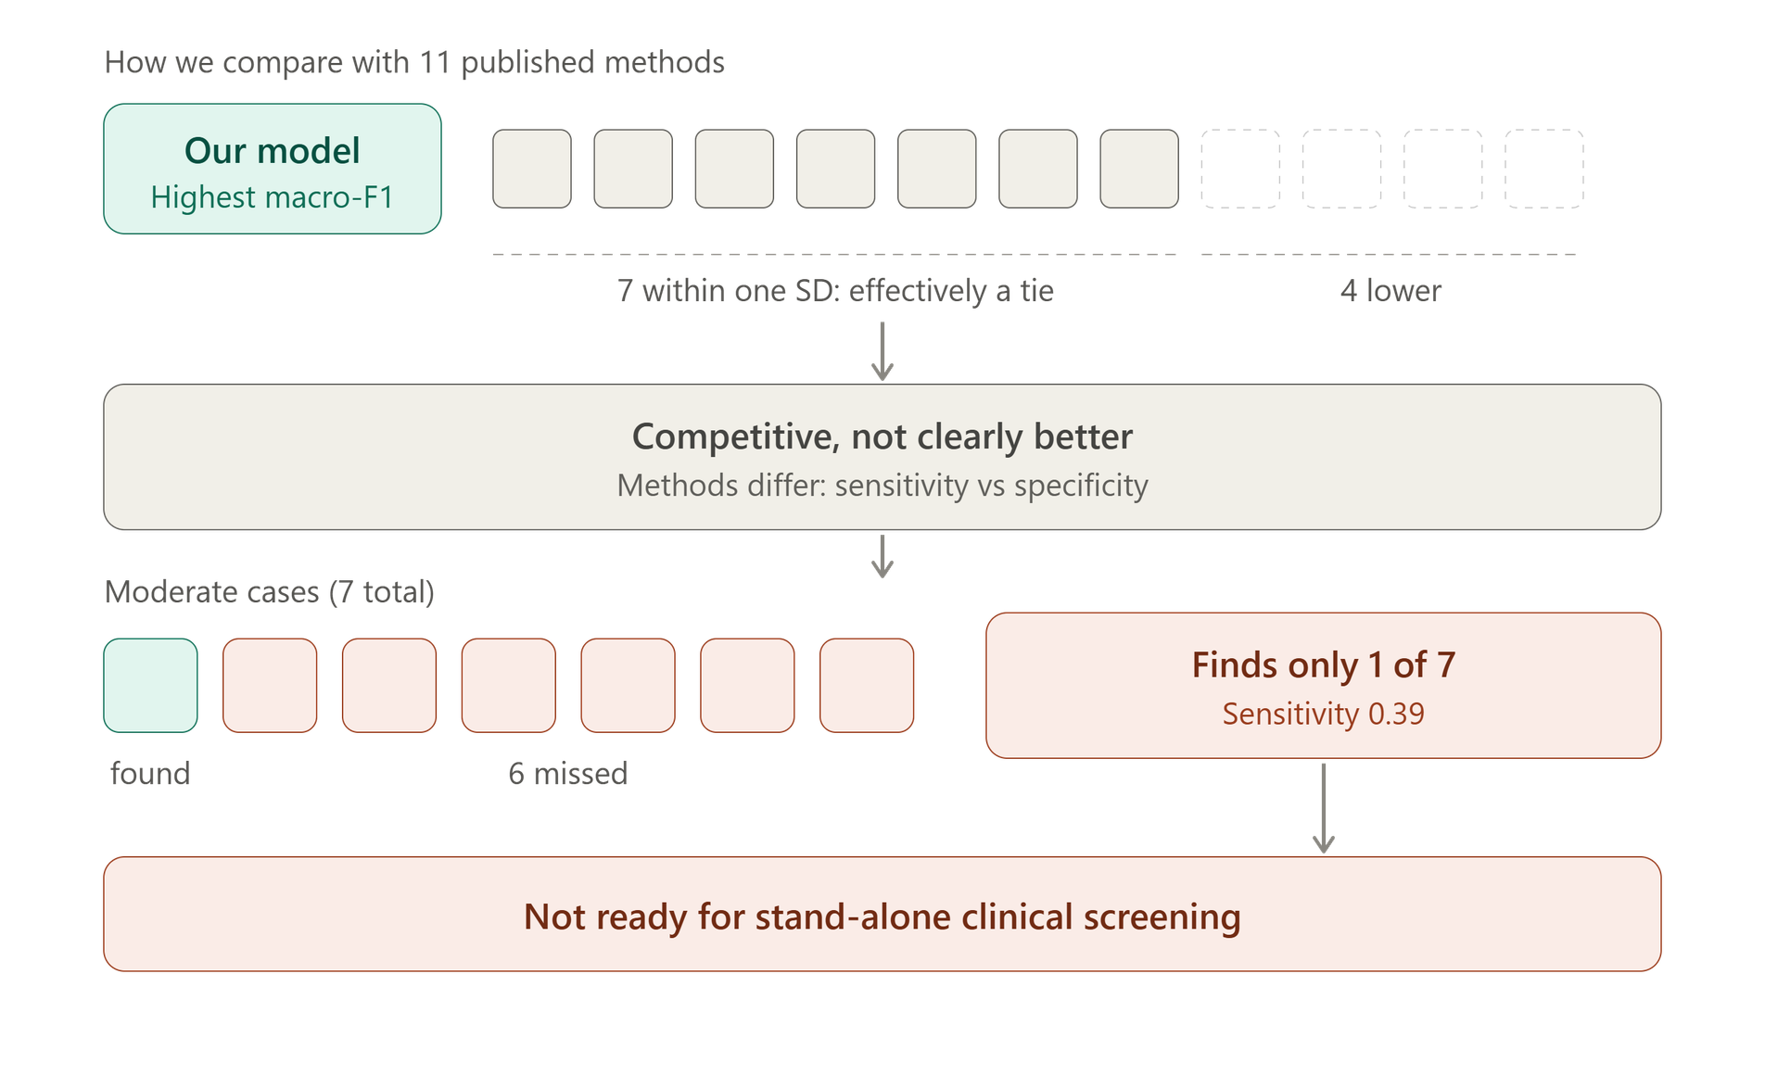
3.3 Interpreting the Experimental Findings
(Discussion)
19

Slide 20
4.
Conclusion
20

Slide 21
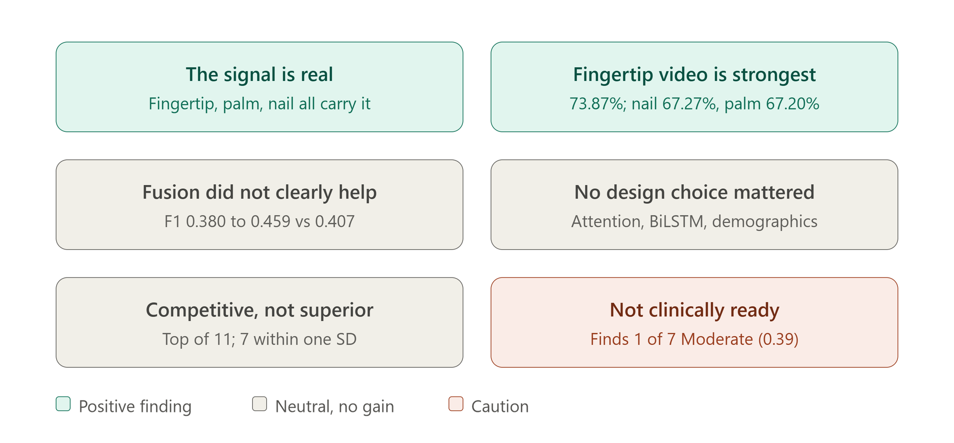
4.1 Conclusions and Research Implications
(Conclusions)
21

Slide 22
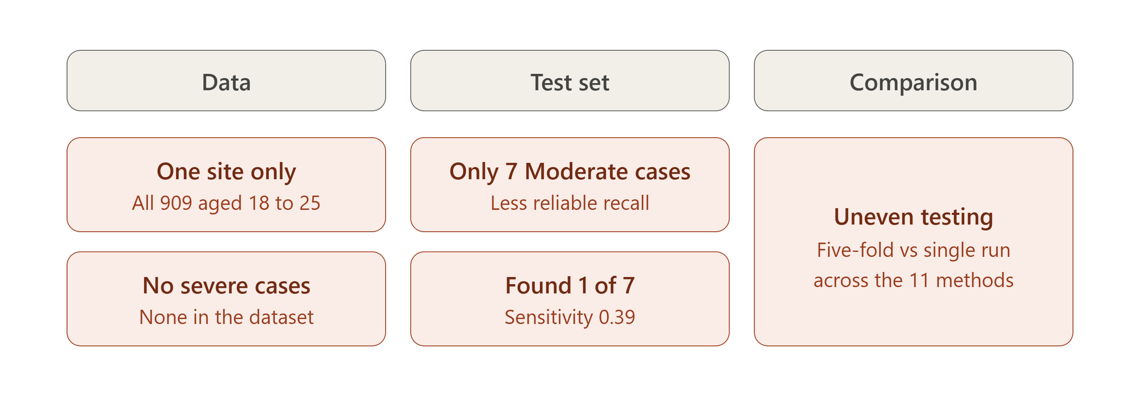
4.2 Limitations of This Study
22

Slide 23
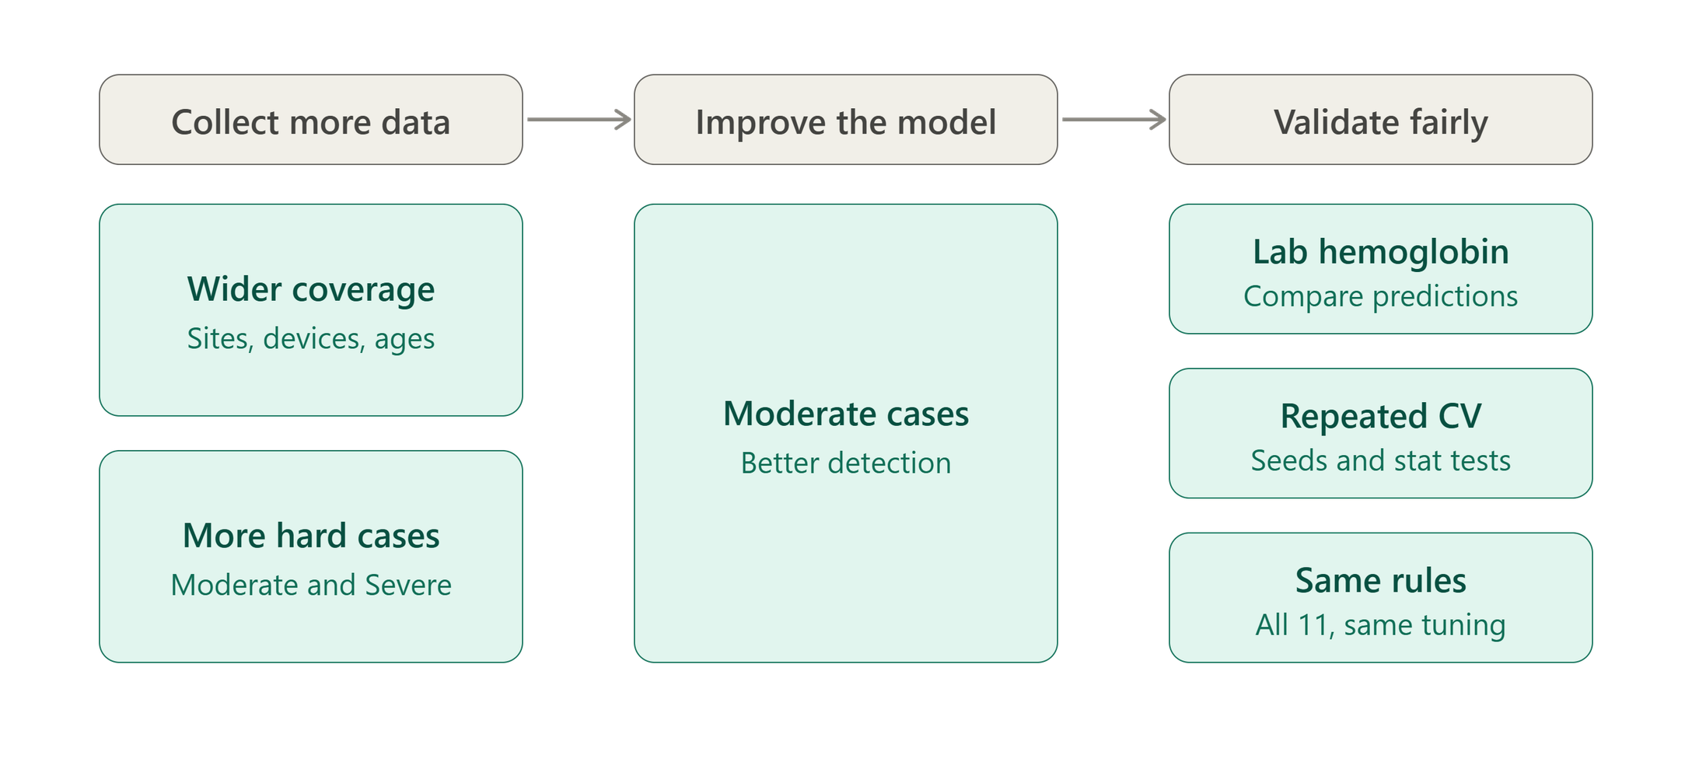
4.3 Future Work
23

Slide 24
References
Research paper:
https://revistas.unsm.edu.pe/index.php/rcsi/article/view/955
https://drive.google.com/drive/folders/1ztGpMMw0ni_VLqL353Ju34Kvw3WTmTye
Dataset Drive link:
  [1] E.-T. Lin, S.-C. Lu, A.-S. Liu, C.-H. Ko, C.-H. Huang, C.-L. Tsai, and L.-C. Fu, “Deep Learning-Based Model for Non-invasive Hemoglobin Estimation via Body Parts Images: A Retrospective Analysis and a Prospective Emergency Department Study,” Journal of Imaging Informatics in Medicine, vol. 38, no. 2, pp. 775–792, 2025, doi: 10.1007/s10278-024-01209-4.
  [2] P. Appiahene, J. W. Asare, E. T. Donkoh, G. Dimauro, and R. Maglietta, “Detection of iron deficiency anemia by medical images: A comparative study of machine learning algorithms,” BioData Mining, vol. 16, art. no. 2, 2023, doi: 10.1186/s13040-023-00319-z.
  [3] S. Mythili, R. A. Chelsia, and M. Thirishaa, “Anaemia Detection using Deep Learning by processing Conjunctiva, Fingernails, Palm and Tongue Images,” International Research Journal on Advanced Engineering Hub (IRJAEH), vol. 2, no. 9, pp. 2433–2439, 2024, doi: 10.47392/IRJAEH.2024.0333.
  [4] K. Kumar, A. Gupta, N. Gupta, M. Asim, and S. Srivastava, “Non-Invasive Hemoglobin Prediction: A Machine Learning Approach,” in Proceedings of the 2025 5th International Conference on Advancement in Electronics & Communication Engineering (AECE), 2025, pp. 620–625, doi: 10.1109/AECE67531.2025.11386530.
  [5] S. Krithika, A. K. R. Poreddy, T. Balakrishna, and P. Kokil, “A Multi-input Deep Neural Network Framework for Non-invasive Detection of Anemia using Finger Nail Images,” in Proceedings of the 2024 10th International Conference on Bio Signals, Images, and Instrumentation (ICBSII), 2024, pp. 1–6, doi: 10.1109/ICBSII61384.2024.10564094.
  [6] A. S. Nousir, A. M. Attia, M. Salama, A. Mostafa, M. Osama, H. A. Khalil, B. Mohamed, and D. Darwish, “Anemia Detection from Eyes, Palm and Fingernails with Machine Learning Models,” International Journal of Computer Science and Engineering Survey, vol. 15, no. 6, pp. 1–9, 2024, doi: 10.5121/ijcses.2024.15601.
  [13] R. Murugeswari, S. M. Kumar, T. H. Reddy, S. R. Reddy, and S. Eliyas, “Iron Deficiency Anemia Detection Using Deep CNN and Ensemble Learning,” in Proceedings of the 2025 International Conference on Computational Robotics, Testing and Engineering Evaluation (ICCRTEE), 2025, doi: 10.1109/ICCRTEE64519.2025.11052932.
24

Slide 25
References
  [7] H. Sabir, K. U. Khan, O. Ishaq, A. Alazeb, H. Aljuaid, A. Algarni, and J. Park, “Fingertip Video Dataset for Non-Invasive Diagnosis of Anemia Using ResNet-18 Classifier,” IEEE Access, vol. 12, pp. 68880–68892, 2024, doi: 10.1109/ACCESS.2024.3398353.
  [8] S. Das and M. Bhattacharjee, “Image-Based Sensing of Leukonychia for Early Diagnosis of Anemia Using a Smartphone Application,” IEEE Sensors Letters, vol. 6, no. 11, pp. 1–4, 2022, doi: 10.1109/LSENS.2022.3217010.
  [9] S. Kato, K. Chagi, Y. Takagi, M. Hidaka, S. Inoue, M. Sekiguchi, N. Adachi, K. Sato, H. Kawai, and M. Kato, “Machine/deep learning-assisted hemoglobin level prediction using palpebral conjunctival images,” British Journal of Haematology, vol. 205, no. 4, pp. 1590–1598, 2024, doi: 10.1111/bjh.19621.
  [10] J. R. Navarro-Cabrera, M. A. Valles-Coral, M. E. Farro-Roque, N. Reátegui-Lozano, and L. Arévalo-Fasanando, “Machine vision model using nail images for non-invasive detection of iron deficiency anemia in university students,” Frontiers in Big Data, vol. 8, art. no. 1557600, 2025, doi: 10.3389/fdata.2025.1557600.
  [11] K. K. Mohammed, N. Dahmani, R. Ahmed, A. Darwish, and A. E. Hassanien, “An Explainable AI and Optimized Multi-Branch Convolutional Neural Network Model for Eye Anemia Diagnosis,” IEEE Access, vol. 13, pp. 71840–71857, 2025, doi: 10.1109/ACCESS.2025.3560689.
  [12] A. A. Nababan, M. Turnip, A. Dharma, and Yennimar, “A Neural Network Optimization Approach for Anemia Prediction Using Image Pixels and Hemoglobin Data,” in Proceedings of the 2024 IEEE International Conference on Control & Automation, Electronics, Robotics, Internet of Things, and Artificial Intelligence (CERIA), 2024, pp. 1–6, doi: 10.1109/CERIA64726.2024.10915131.
25

Slide 26
Thank You
26

Slide 27
Questions and Answers
27

